Slide 1
Cardiovascular Disease Prediction

Slide 2
OUTLINE
Introduction
Data Description
Cleaning
EDA
Modeling
Tools

Slide 3
INTRODUCTION :
Cardiovascular disease is a class of diseases that involve the heart or blood vessels, And are the leading cause of death worldwide by representing.
The goal of this project is to build machine learning models to classify or identify patient's condition on Cardiovascular Disease based medical examination for the patient.

Slide 4
Data Description :
DATA COUNT
THE Target VARIABLE
It contained 70,000 observations and 13 features.
Disease
After cleaning
Source
it became 61,296 observations and 24 features.
from Kaggle.

Slide 5
Data Cleaning :
Check null. Remove outlier.
Drop column. Feature Engineering.
Rename columns. Get Dummies.
convert [age] from days to years. Check data balanced.

Slide 6
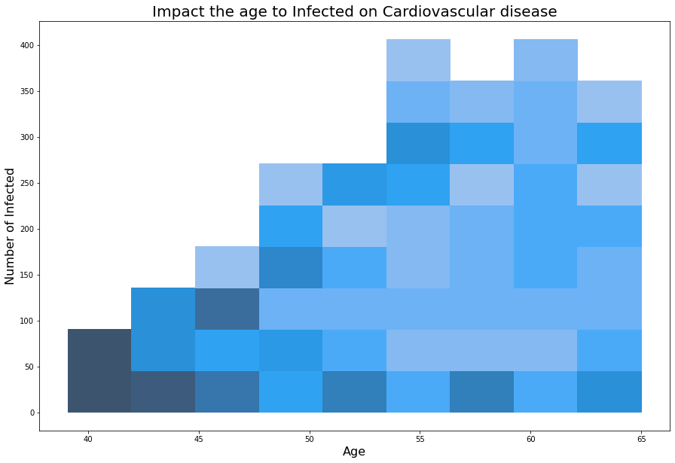
EDA :

Slide 7
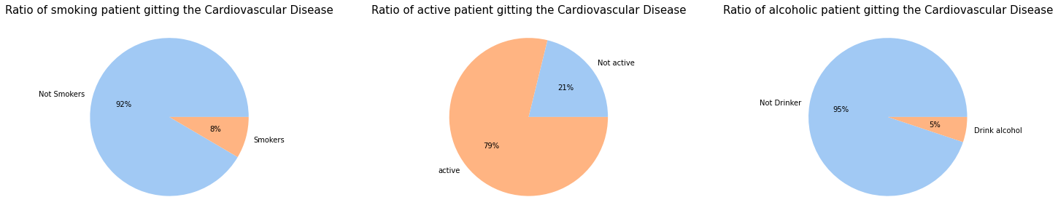
EDA :

Slide 8
Modeling : Beasline model
Model | Training | validation
Logistic Regression | 0.709 | 0.693

Slide 9
Improving models:
Dealing with outliers
Add features engineering
Scaling dataset
GridSearch
Feature Selection

Slide 10
Models:
Model | Training | validation
Logistic Regression | 0.730 | 0.708
MLP Classifier | 0.737 | 0.718
Random forest | 0.745 | 0.724
Extreme Gradient Boosting | 0.746 | 0.723
Average Voting | 0.744 | 0.721
Stacking Classifier | 0.744 | 0.723
Note: these the best 5 models fitting with this dataset

Slide 11
Models: Feature Selaction
Model | Training | validation
Logistic Regression | 0.729 | 0.726
MLP Classifier | 0.735 | 0.737
Random forest | 0.745 | 0.732
Extreme Gradient Boosting | 0.746 | 0.739
Average Voting | 0.743 | 0.737
Stacking Classifier | 0.743 | 0.739

Slide 12
Selected model :
Model | Training | Testing
Extreme Gradient Boosting | 0.739 | 0.737

Slide 13
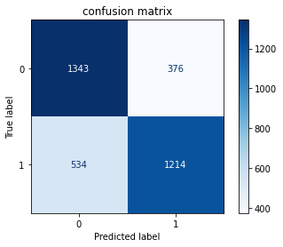
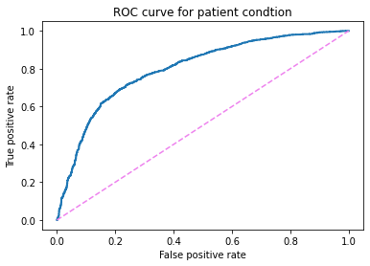
Confusion Matrix AND ROC :
ROC AUC score = 0.8

Slide 14






TOOLS:

Slide 15

Does anyone have any questions?
Hala Alanzi
Mashael Alfehaid
GitHub @ halaalanzi
GitHub @ Mashael999

